Slide 1


Understanding Your Report
2025 Historic Preservation Educational Programming (HPEP)

Slide 2
Main Components
Building Survey
Design
Economy
Action Steps
Resources
01
02
03
04
05
The building survey is an evaluation of the building’s existing condition based on historical research, field observation, and owner input.
The Design Education Service portion has recommendations to improve and sustain the historic nature of a building’s storefront based the on Secretary of Interior’s Standards.
The economy section features census and ESRI data to better understand the market potential for the community. Full reports are featured in the appendix.
Action steps provide a starting point to begin the desired and recommended work.
The resources section educates participants on ways to restore and maintain historic structures.

Slide 3
01
BUILDING
SURVEY

Slide 4
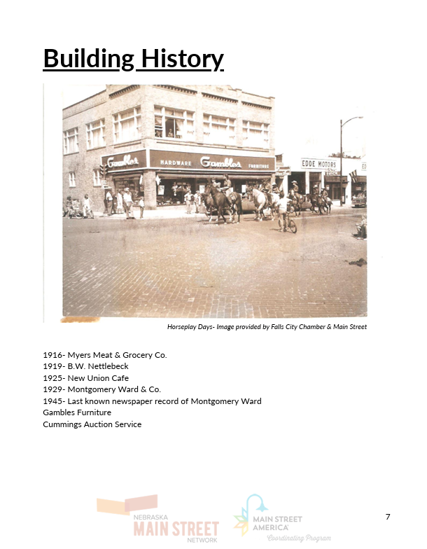
Purpose
The purpose of this section is to better understand the condition and context of the building.
BUILDING SURVEY

Slide 5
Contents
Building History
  General history of the building and area based on newspaper articles, local historical societies, or other local websites.
Survey
  Results from the field survey including goals, previous efforts, concerns, vacancy description, and damage. Additionally, conditions such as utilities and fire safety are ranked and described. Finally, the building’s historical significance is described. Most buildings are in a historic district, or are old enough to be considered local landmarks.
BUILDING SURVEY

Slide 6
02
DESIGN
EDUCATION

Slide 7

Purpose
The purpose of the Design Education Service is to educate on Historic Preservation techniques and recommend changes based on the Secretary of Interior’s Standards for Rehabilitation.
DESIGN EDUCATION

Slide 8
Disclaimer
The Nebraska Main Street Network provides these design case studies as an educational tool for partner communities. The illustrations are conceptual in nature only and take no specific consideration of local codes, standards, permit process or design review.
DESIGN EDUCATION

Slide 9
Contents
Service Information
  The Four-Points and information about how Nebraska Main Street conducts the service.
Case Study
  An evaluation of the building’s physical and aesthetic condition along with basic information and observations.
  Recommendations based on Interior’s Standards.
  Before and after images that highlight the recommended alterations.
Glossary of Terms
  Defines terms that might be used throughout the Design Education Packet.
DESIGN EDUCATION

Slide 10
03
LOCAL
ECONOMY

Slide 11
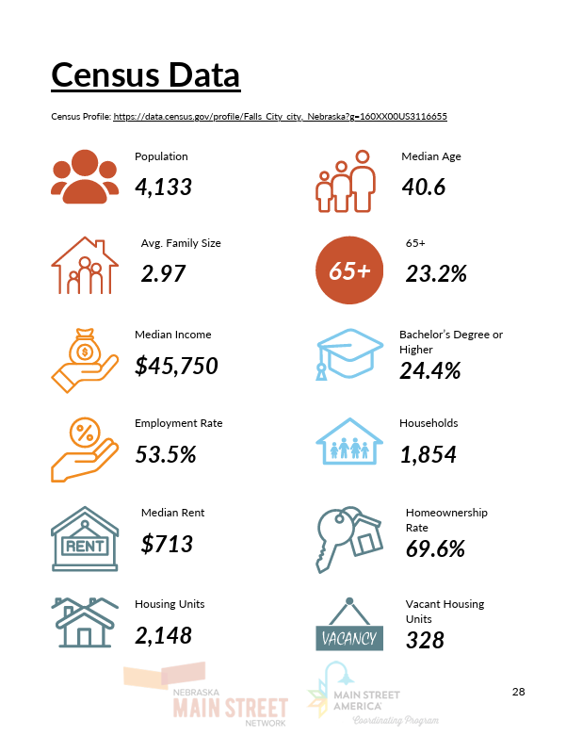
Purpose
The economy section demonstrates the identity of the community through market evaluations and census data.
LOCAL ECONOMY

Slide 12
Contents
Census Data
  Census data highlights factors such as population, age, housing, income, and other relevant information.
ESRI Data- Zip Code
  Features annual spending habits and disposable income. Tapestry identification gives insight into the type of people that live in the area and includes psychographics.
Market Reports
  Trade Area
  Retail Demand Outlook
  Retail Demand by Industry
  Retail Market Potential
LOCAL ECONOMY

Slide 13
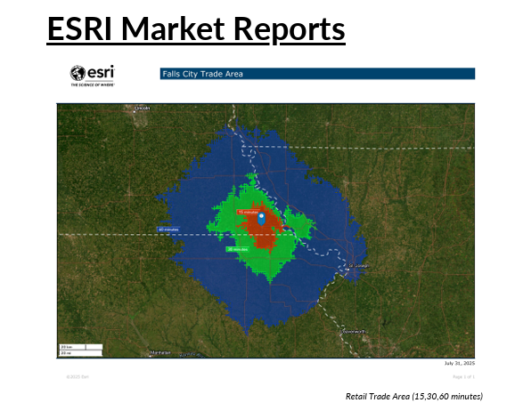
Trade Area
A trade area is a geographic region in which a business (or in this case community) draws most of their customers. The provided chart and information includes the 15, 30, and 60 minute radius.
LOCAL ECONOMY

Slide 14
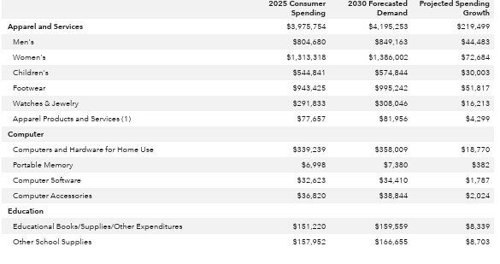
Retail Demand Outlook
The retail demand outlook report predicts the projected spending growth through 2030 by monetary value. This demonstrates current and projected consumer spending monetarily compared to growth percentages.
LOCAL ECONOMY

Slide 15
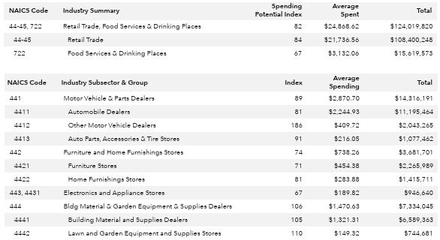
Retail Demand by Industry
This report further breaks down retail demand, providing a spending potential index (SPI). The SPI is household-based, and represents the amount spent for a product or service relative to a national average of 100.
LOCAL ECONOMY

Slide 16
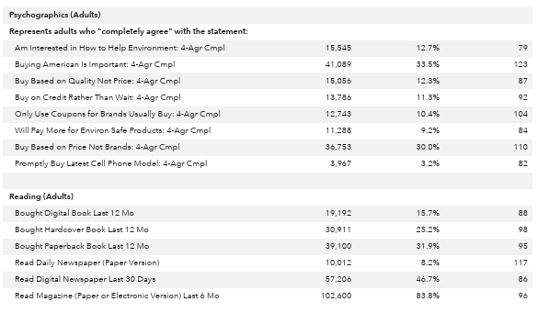
Retail Market Potential
The retail market potential report calculates a Market Potential Index (MPI) that measures the likelihood of adults or households in the specific trade area to exhibit consumer patterns. An MPI of 100 represents the U.S. average.
LOCAL ECONOMY

Slide 17
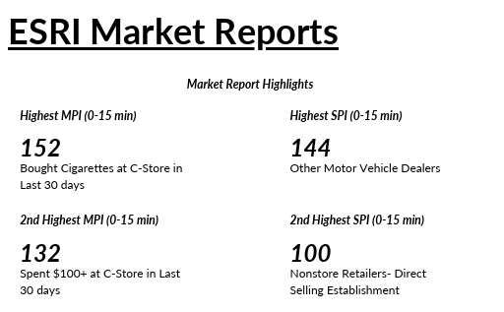
Using Market Data for Business Growth
SPI and MPI can be understood in the same way as a score of 100 represents the national average. A score over 100 depicts higher growth opportunities while a score below 100 is less likely to see economic growth.
It is important to consult the retail demand outlook to consider whether or not the growth is considerable enough for new or sustaining current business.
  Example: An SPI or MPI might say 120, but the Retail Demand Outlook might say that spending increase in that sector is only $2,000.
LOCAL ECONOMY

Slide 18
04
ACTION
STEPS

Slide 19
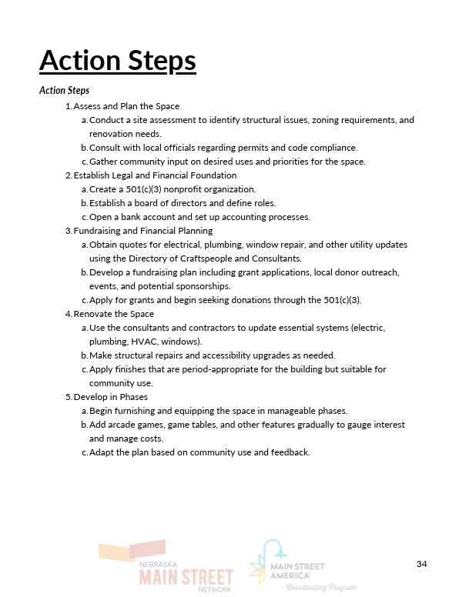
Purpose
The action steps are meant to break down the goals and recommendations highlighted in the report into achievable steps.
Action steps are recommendations and are not exact as each project is different and will likely encounter different challenges.
ACTION STEPS

Slide 20
05
RESOURCES
& FUNDING

Slide 21
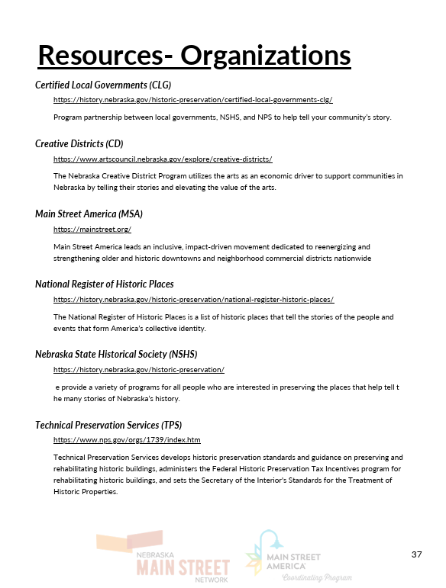
Purpose
This section highlights organizations and specific grants that can provide services or monetary support for development of properties as well as other services.
The main goal of the resources section is to educate participants on ways to restore and maintain historic properties.
RESOURCES & FUNDING

Slide 22
Contents
Resources
  Organizations
  Design
  Economic Vitality
  Promotion and Organization
Funding
  Organizations & Businesses
  Grants & Programs
RESOURCES & FUNDING

Slide 23
06
PARTICIPANT
SURVEY

Slide 24
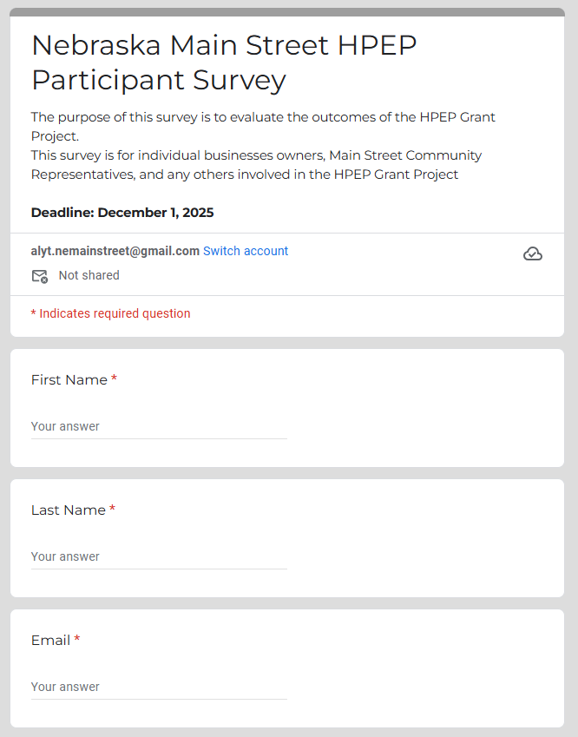
Purpose
The participant survey allows us to measure the success of the project based qualitative and quantitative feedback. This feedback will be featured in our final comprehensive report and will help Nebraska Main Street conduct similar programs in the future.
Survey Deadline is December 1, 2025
SURVEY LINK
PARTICIPANT SURVEY

Slide 25
This material was produced with assistance from the Historic Preservation Fund, administered by the National Park Service, Department of the Interior under Grant Number P23AF01076 and P24AF01925. Any opinions, findings, and conclusions or recommendations expressed in this material are those of the author(s) and do not necessarily reflect the views of the Department of the Interior.

