Slide 1

Historic Tax Incentives
Chris Usler, Historic Incentives Coordinator
Chris.Usler@Nebraska.gov
(531)-350-8072

Slide 2


Federal Historic Tax Credit
Who Administers the Program?
  National Park Service (NPS) & Internal Revenue Service (IRS)
  In partnership with State Historic Preservation Offices (SHPO)
  Angela Shearer, NPS TPS, Supervisory Historian
  Chris Usler, NeSHPO, Historic Incentives Coordinator
Notes:
IRS governs all tax aspects (credits, easements, deductions)
NPS approval ≠ IRS approval for tax purposes
Applicants must consult IRS or tax professionals for financial/tax guidance

Slide 3
Federal Historic Tax Credit
What Is a Tax Credit?
  Tax credit ≠ income tax deduction.
    Tax deduction lowers the amount of income subject to taxation.
      Ex: Claiming a $1,000 laptop deduction reduces taxable income by $1,000.
    Tax credit lowers the amount of tax owed.
      Ex. $1 tax credit reduces the amount of income tax owed by $1.
Notes:
A tax credit is not the same thing as a tax deduction, which you use to reduce your taxable income.
Instead, a tax credit reduces the income tax you owe. So, when you do your yearly tax return, tax credits don’t reduce the income that can be taxed, you can use tax credits to help pay what you owe in tax.

Slide 4
Federal Historic Tax Credit
20% Income Tax Credit
  Equals 20% of the amount spent in a certified rehabilitation of a certified historic structure.
      Ex. $1,000,000 spent = $20,000 tax credit used to reduce the amount of taxes you owe
  The credit is allocated ratably over a 5-years on your federal income tax return.
    [IRC Section 47 and Treas. Reg. 1.47-7]
  Rehab = renovation, restoration, or reconstruction of a building
  Rehab ≠ an enlargement or new construction.
    [IRC 47(c)(2) and Treas. Reg. 1.48-12(b)(2)(iv)]
Notes:
Basically?
The tax credit is an incentive to rehabilitate historic buildings.
If your rehabilitation and expenses qualify, you may claim a tax credit equal to 20% of your qualified expenses.

Slide 5
Federal Historic Tax Credit
Who May Apply?
  Owner (per 36 CFR 67.2):
    Person, partnership, corporation, or public agency holding fee simple interest
    Entities recognized by the IRS for tax benefits
  Non-profits and government subdivisions are not eligible

Slide 6
Federal Historic Tax Credit
Basic Requirements
  Building must be a “certified historic structure”
  Project must be a “substantial rehabilitation”
  Property must be depreciable / income-producing

Slide 7
Federal Historic Tax Credit
How to Get “Certified Historic Structure” Status?
  Must be a “building” not a bridge, ship, railroad car, or dam.
  Must be listed (or eligible) on the National Register of Historic Places (NRHP)
    individually as a Contributing Resource within an NRHP historic district
  Already a CHS – A single building individually listed in the NRHP
  Must Submit HPCA Part 1 for SHPO/NPS determination for:
    Individual listing with multiple buildings (House + garage, Complex)
    Contributing buildings within NRHP-listed historic districts
  Not Yet Listed in the NRHP?
    Submit Part 1 of the HPCA and request a Preliminary Determination that the building is:
      Eligible for Individual listing
      Eligible as a contributing resource to an existing or potential historic district
  ***The building must be officially listed by Part 3 submittal / completion of work.

Slide 8
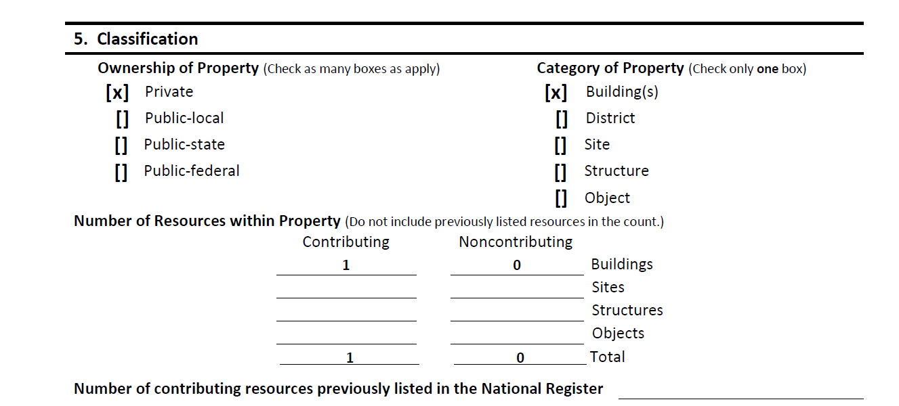
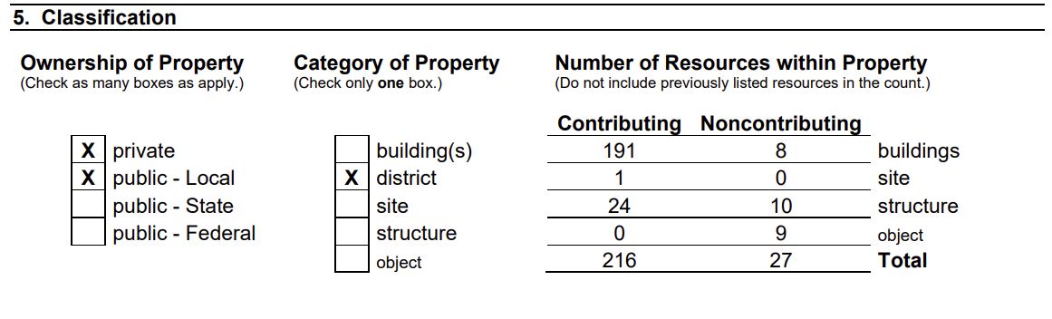
Federal Historic Tax Credit

Slide 9
Federal Historic Tax Credit
Substantial Rehab Test & QREs
Qualified rehab costs must exceed the greater of $5,000 or the building’s adjusted basis.
Qualified Rehabilitation Expenditures
  QREs = the expenses that factor into the 20% credit.
    Rehab work on the historic building (roof, repointing, windows, flooring, drywall, HVAC)
    Not eligible = new additions, appliances, landscaping.

Slide 10
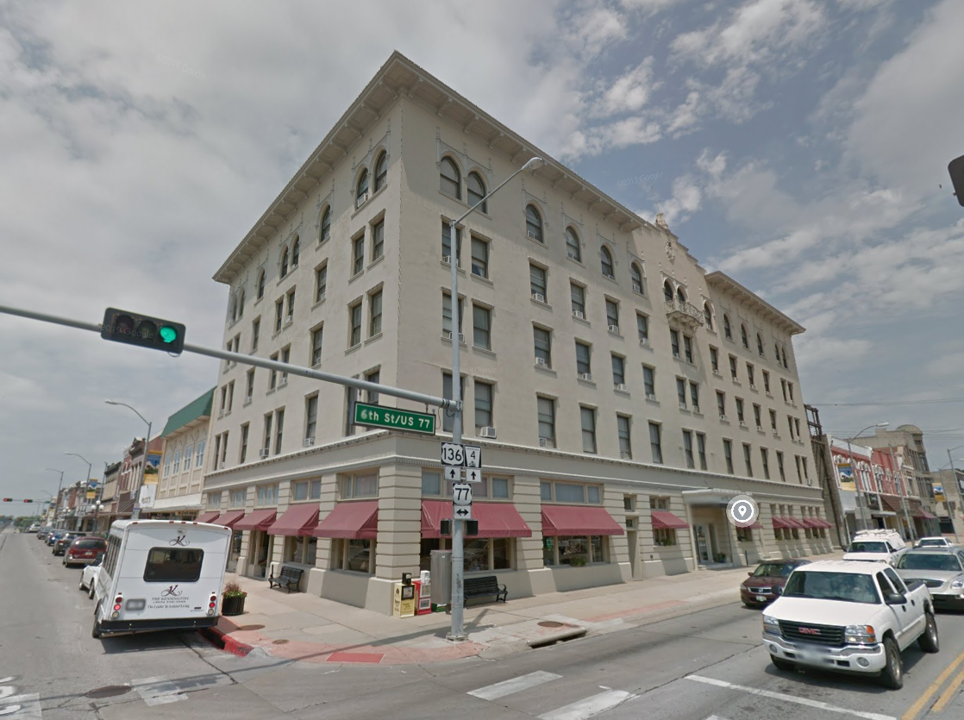
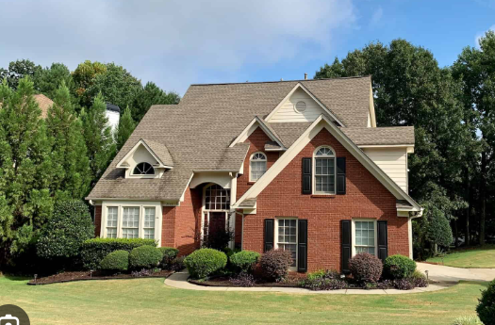
Federal Historic Tax Credit
Property Must Be Depreciable / Income Producing
  Depreciation = annual “wear & tear” tax deduction for buildings.
  Why Only Depreciable Buildings?
    HTC is an investment incentive designed to encourage businesses and developers to put money into historic building projects that drive economic revitalization, not a subsidy for improving personal residences.
  Buildings with income-producing uses:
    Business, commercial, industrial, agricultural, or rental housing
  Not eligible:
    Owner-occupied residences (single-family houses, condos)
    Non-taxable, non-depreciable properties (like churches still used as churches)

Slide 11
Federal Historic Tax Credit
Historic Preservation Certification Application (HPCA) - What’s Required?
  Part 1 – Evaluation of Significance
    Not required if single building is individually listed on NRHP
  Part 2 – Description of Rehabilitation
  Part 3 – Request for Certification of Completed Work
Notes:
Maybe move SOIS into Part 2?

Slide 12

Federal Historic Tax Credit
HPCA – How to Apply: Electronic Submission
    Submit application + all materials electronically to SHPO
      https://history.nebraska.gov/historic-preservation/federal-historic-tax-credit/
    Forms are available as fillable PDFs on the NPS website (or just email me/NPS)
    Follow SHPO/NPS guidance on file format, naming, and organization

Slide 13
Federal Historic Tax Credit
HPCA – When to Apply
  Apply at any time during the year.
  Apply before starting rehabilitation work whenever possible.
    Applicants who undertake rehabilitation projects without prior approval from the NPS do so at their own risk.
  The application parts may be sent separately or together, but if they are sent separately, Part 1 must precede Part 2.
  Consider Timing -- Projects are not limited to 24 months, but…
    24mo window to meet the substantial rehab test. Must end in the taxable year the building is placed in service.
Notes:
Measuring period for meeting the substantial rehab test is 24 months / 60 months for larger phased projects. So…

Slide 14
Federal Historic Tax Credit
HPCA – Submittal & Review Process
  Applicant
    submits application electronically to SHPO
  SHPO
    Ensures application is complete, recommends actions and forwards to NPS
  NPS
    Makes final determination
    May differ from the recommendation of the SHPO.
    Notifies the applicant of the decision and provides a copy of all decisions to the IRS and the SHPO.

Slide 15
Federal Historic Tax Credit
HPCA – Review Times
  Complete application?
    SHPO = generally 30 days
    NPS = generally 30 days
  Incomplete application?
    Will be placed on hold for additional information or returned to the applicant for resubmission.
  Review of Part 2 and Part 3 applications by the NPS does not start until payment of the review fee has been received.

Slide 16
Federal Historic Tax Credit
Part 1 – Evaluation of Significance
  Cover Sheet
    Must use official cover sheet with applicant’s e-signature and date.
  Description of Physical Appearance
    Describe exterior & interior as existing before rehab.
      Architectural style
      Materials (brick, wood, etc.)
      Roof type (flat, gable, hipped, etc.)
      Stories & building plan (rectangular, L-shaped, etc.)
      Distinguishing features (windows, chimneys, porches, decorative interiors).
      Construction History & Record alterations (additions, window infill, interior changes).
      Mention outbuildings (barns, sheds, garages).
      Relate building to district/neighborhood
  Statement of Significance
    Summarize the building’s significance or how building contributes to district’s significance.
    Period of Significance; Applicable National Register Significance Criteria
    Need help? See National Register Bulletin 16b: https://www.nps.gov/subjects/nationalregister/upload/NRB16B-Complete.pdf

Slide 17
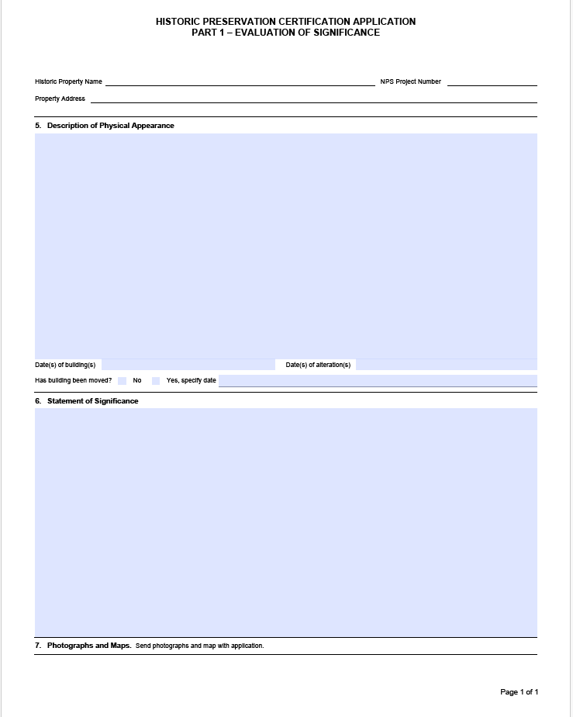
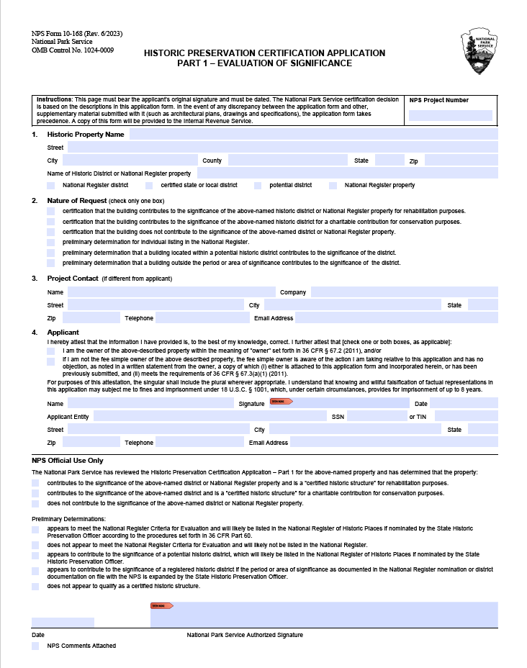
Federal Historic Tax Credit

Slide 18
Federal Historic Tax Credit
  Additional Part 1 Requirements
    Ownership Statement: If not the fee simple owner, provide written consent from the owner acknowledging and not objecting to the application.
    Photographs w/ Captions & Photo Key
      Submit current photos (before rehab or at time of easement application).
      Site plan or aerial for exterior
      Floor plan for interior
    Map: Provide site plan or district map with property highlighted.
      Show all buildings if multiple
      Identify applicant’s portion if partial ownership/control

Slide 19
Federal Historic Tax Credit
Part 2 – Description of Rehabilitation
  Cover Sheet
    Must use official cover sheet with applicant’s e-signature and date.
    Rehab Costs: Report total estimated QREs
  Detailed Description of Rehabilitation Work
    Describe existing condition and proposed scope for all work, not just credit-eligible work.
  Minimum Required Documentation
    Ownership Statement
    Photographs & Photo Key – Comprehensive photo coverage!
    Architectural Drawings/Sketches:
      Existing conditions + proposed work/new additions
      Floor plans (sections/elevations if needed)

Slide 20
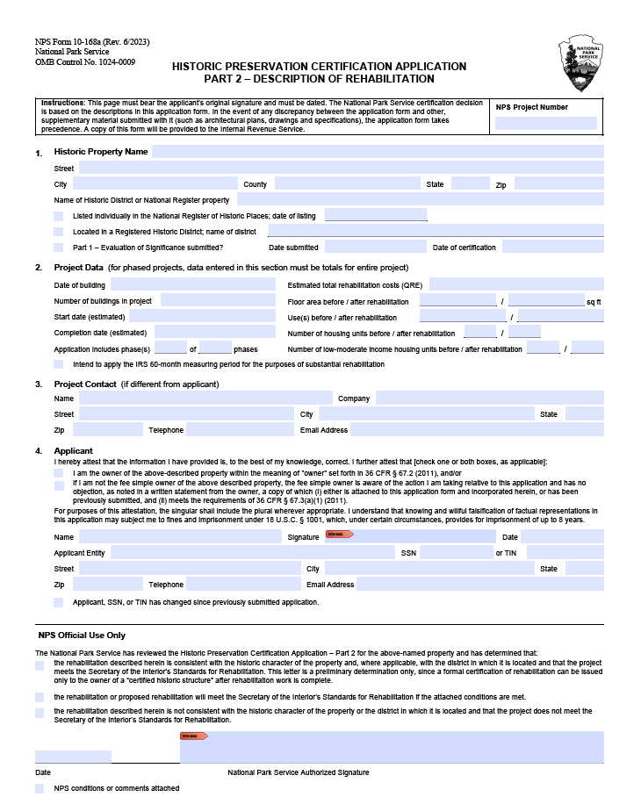
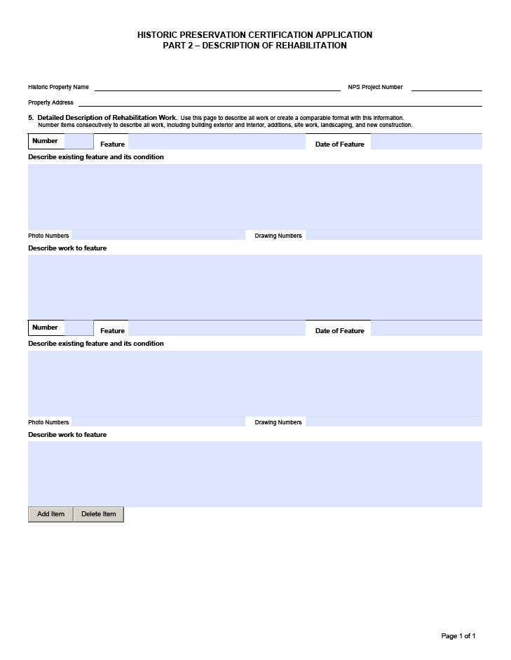
Federal Historic Tax Credit

Slide 21
Federal Historic Tax Credit
Part 2 – Description of Rehabilitation
Evaluation Process
  Reviewed under Secretary of the Interior’s Standards for Rehabilitation
  Standards apply to all work: interior, exterior, additions, site, and related new construction.
  Assessed on the entire project (cumulative effect), not individual elements.
  Reviews are performed reasonably with considerations: economic/technical feasibility.
  The Secretary’s Standards override other codes/regulations when determining consistency with historic character.

Slide 22
Federal Historic Tax Credit
Secretary of the Interior’s Standards for Rehabilitation, codified in 36 CFR 67.7
A property shall be used for its historic purpose or be placed in a new use that requires minimal change to the defining characteristics of the building and its site and environment.
The historic character of a property shall be retained and preserved. The removal of historic materials or alteration of features and spaces that characterize a property shall be avoided.
Each property shall be recognized as a physical record of its time, place, and use. Changes that create a false sense of historical development, such as adding conjectural features or architectural elements from other buildings, shall not be undertaken.
Most properties change over time; those changes that have acquired historic significance in their own right shall be retained and preserved.
Distinctive features, finishes, and construction techniques or examples of craftsmanship that characterize a historic property shall be preserved.
Notes:
Use & Character: Rehabs need to retain the building’s historic use or convert it into a compatible new use; retain and preserve its historic character.
Authenticity: Avoid creating a false history; preserve changes that have become historically significant.
Features & Craftsmanship: Preserve distinctive features, finishes, and construction techniques.
Repair vs. Replace: Repair deteriorated features when possible; replacements must match original design and materials, based on evidence.

Slide 23
Federal Historic Tax Credit
Secretary of the Interior’s Standards for Rehabilitation
Deteriorated historic features shall be repaired rather than replaced. Where the severity of deterioration requires replacement of a distinctive feature, the new feature shall match the old in design, color, texture, and other visual qualities and, where possible, materials. Replacement of missing features shall be substantiated by documentary, physical, or pictorial evidence.
Chemical or physical treatments, such as sandblasting, that cause damage to historic materials shall not be used. The surface cleaning of structures, if appropriate, shall be undertaken using the gentlest means possible.
Significant archeological resources affected by a project shall be protected and preserved. If such resources must be disturbed, mitigation measures shall be undertaken.
New additions, exterior alterations, or related new construction shall not destroy historic materials that characterize the property. The new work shall be differentiated from the old and shall be compatible with the massing, size, scale, and architectural features to protect the historic integrity of the property and its environment.
New additions and adjacent or related new construction shall be undertaken in such a manner that if removed in the future, the essential form and integrity of the historic property and its environment would be unimpaired.
Notes:
Treatment Methods: Use the gentlest cleaning methods; avoid destructive treatments (e.g., sandblasting).
Archaeological Resources: Protect and preserve significant archaeological features; mitigate if disturbance is unavoidable.
New Work: Additions or alterations must not destroy historic materials, should be clearly differentiated from the old, yet compatible in size, scale, and design.
Reversibility: New construction should be done so it can be removed without harming the historic property’s integrity.

Slide 24
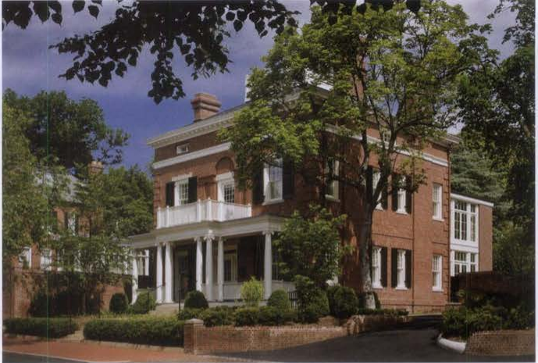
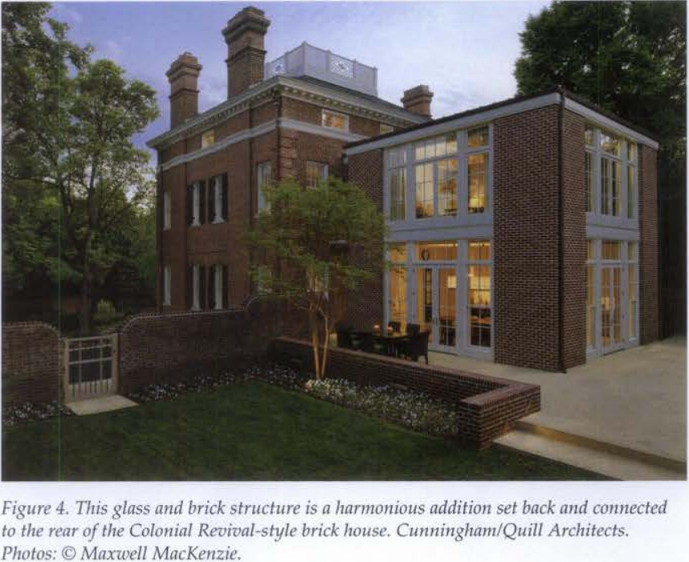
Federal Historic Tax Credit

Slide 25
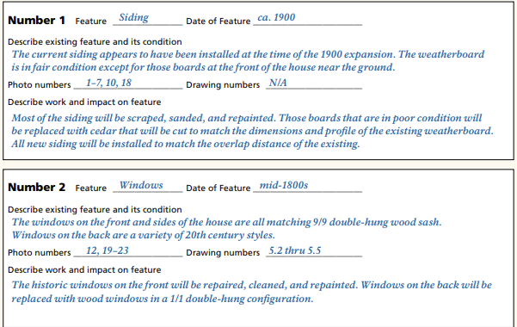
Federal Historic Tax Credit
How to Write a Part 2
  Organization
    Exterior
      Masonry or Siding
      Doors
      Windows
      Cornice
      Roof
    Interior
      1st floor layout, floors, walls, columns, ceilings
      2nd floor and up….
      Stair & elevatos
    MEP+FP
      HVAC
      Electrical
      Plumbing
      Fire Proptection / Sprinklers
    Site
      Landscaping, parking, sidewalks, etc.
Reference related photos/drawings.
Narratives should explain processes (e.g., masonry cleaning); no spec books.
Address Secretary’s Standards & 36 CFR 67.7.
Outline full scope; submit amendments as later phase details develop.

Slide 26
Federal Historic Tax Credit
Special Rehabilitation Concerns
Masonry
  Cleaning – gentlest means possible
  Repointing/repair/replacement -- new mortar, patching, replacement units must match historic composition, color, and tooling. Mockups!
Windows
  Repair historic windows whenever possible.
  If replacement is justified, provide condition photos, repair vs. replacement cost data, and drawings.
  Replacements must closely match originals in size, configuration, details, and materials.
Flooring
  Wood floors must be repaired and retained.
  Replace in-kind where necessary. May consider engineered wood.
  LVT / LVP is not typically an appropriate replacement product for wood.
MEP+FP
  New systems must not damage historic fabric or visually alter spaces.
  Should equipment and ductwork should be exposed or concelaed?

Slide 27
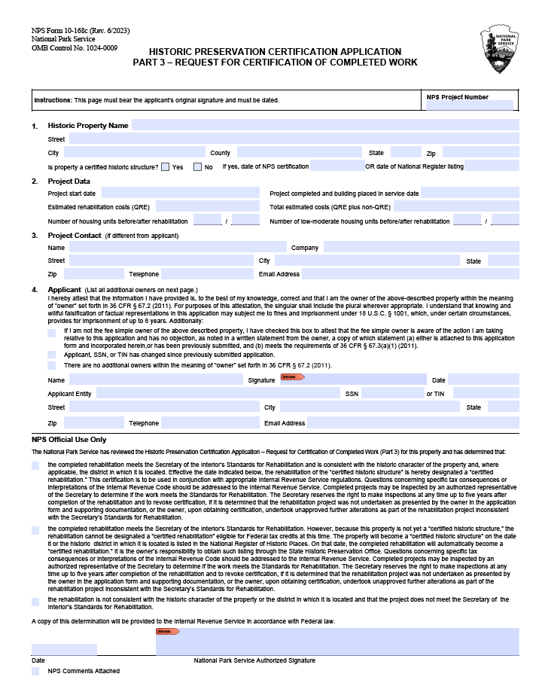
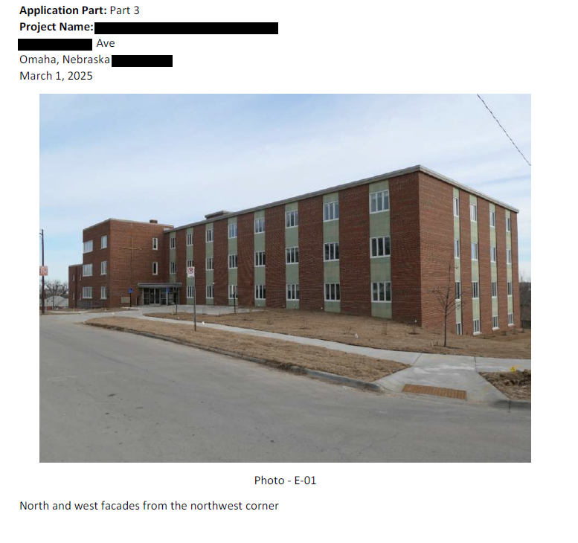
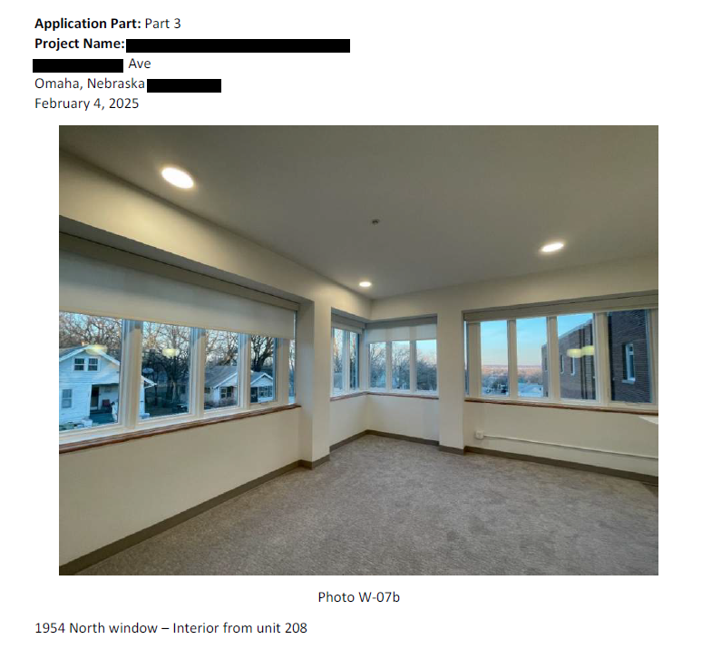
Federal Historic Tax Credit
Part 3 – Request for Certification of Completed Work

Slide 28
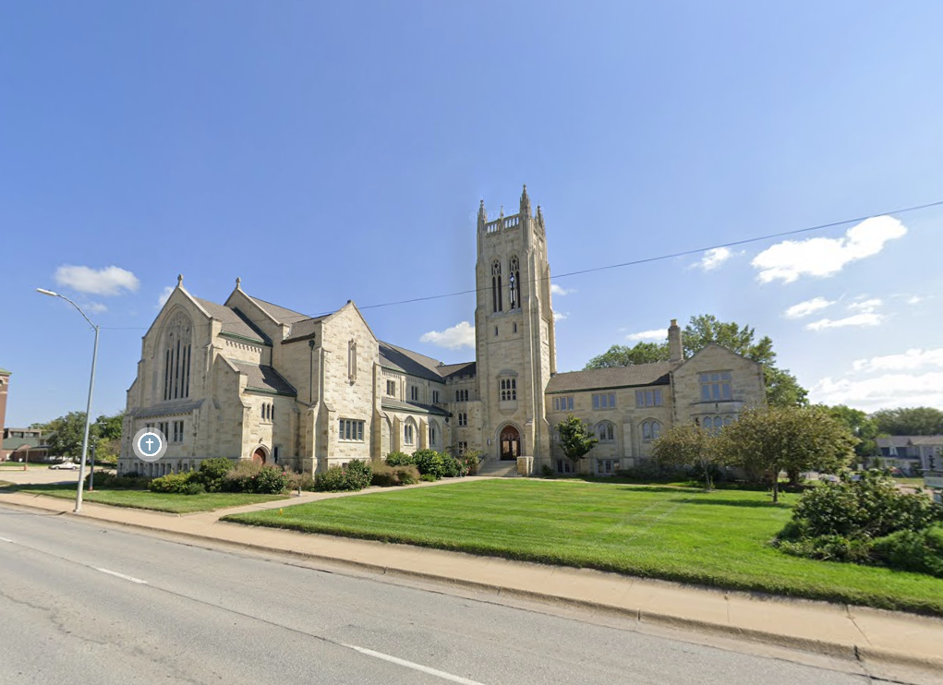
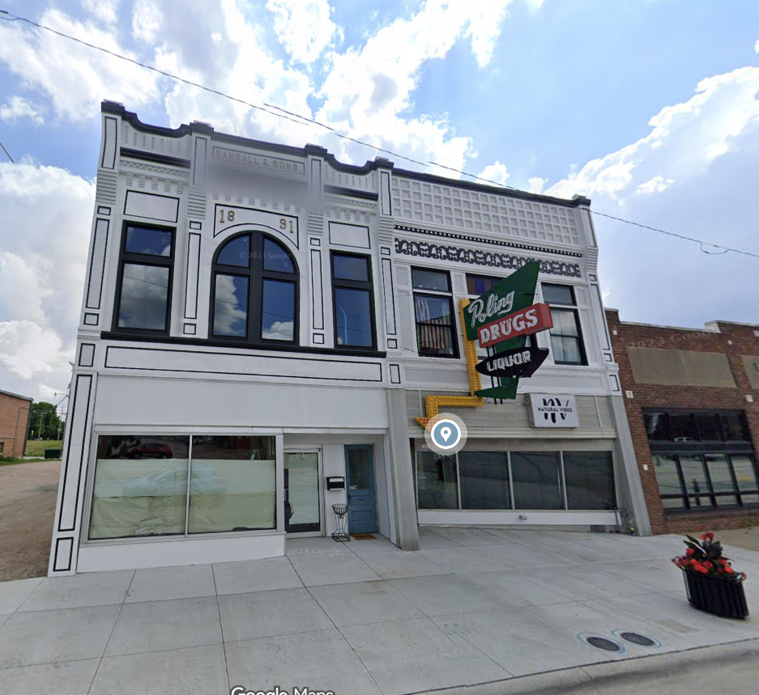
Nebraska Historic Tax Credit

Slide 29
Nebraska Historic Tax Credit
About NHTC
  Started in 2015, reinstated in 2023 under the Nebraska Job Creation and Main Street Redevelopment Act.
  Offers
    25% income tax credit in Douglas, Sarpy, Lancaster
    30% income tax credit in all other counties.
  $2M annual statewide cap; $2M per-project cap. ~46M credit pool.
  5-part application process:
    Parts 1–3: Nebraska State Historical Society reviews.
    Parts 4–5: Nebraska Department of Revenue approves.

Slide 30
Nebraska Historic Tax Credit
NHTC Eligibility & Requirements
Building or aboveground structure used for any purpose, except for a single-family detached residence
Property must be historic at final approval
  Individually listed on the National Register, OR
  Contributing resource in a National Register district, OR
  Locally designated landmark/district.
Part 2 must be submitted before work begins (few exceptions).
Minimum investment: $5,000 in qualified rehab costs.
All work must comply with the Secretary of the Interior’s Standards (reviewed by NeSHPO).
Notes:
Final approval = Part 3 - within twelve months after the date on which the historically significant real property is placed in service:

Slide 31
Nebraska Historic Tax Credit
Before You Apply
  Apply online via the NHTC application portal
    https://history.nebraska.gov/historic-preservation/nebraska-historic-tax-credit-nhtc/
  Read the application instructions and consult early/often with NeSHPO during planning.
  2025 Legislative Update: Must comply with the Foreign Adversary & Terrorist Agent Registration Act.
    No foreign adversarial ownership or investment.
    See Neb. Rev. Stat. §§ 4-203 & 77-3,114; details from Dept. of Revenue available online.
Notes:
*2025 Legislative Change: This incentive program is required to be in compliance with the Foreign Adversary and Terrorist Agent Registration Act. To successfully apply or obtain credits one must ensure no foreign adversarial ownership or investments.

Slide 32
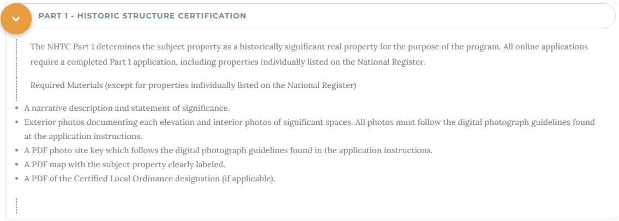
Nebraska Historic Tax Credit
Part 1 – Historic Structure Certification
Notes:
The NHTC Part 1 determines the subject property as a historically significant real property for the purpose of the program.

Slide 33
Nebraska Historic Tax Credit
Part 2 – Qualified Rehab Approval
  Confirms if proposed rehab meets the Secretary of the Interior’s Standards and qualifies for credits.
  Application fee: 0.8% of credits requested.
    Invoice auto-generated in portal.
    Must be paid before review (credit card or check).
  NHTC Part 2 = Fed HTC Part 2 : same organization, level of detail
  Changes to scope after approval require an Amendment.

Slide 34
Nebraska Historic Tax Credit
Part 3 Application – Completed Rehabilitation Approval
Must be submitted within 12 months of project completion/placed in service.
Confirms if completed work meets the Secretary of the Interior’s Standards.
Part 3 Fee
  0.2% of credits requested (invoice auto-generated).
  Must be paid before review (credit card or check).
Next Steps
  Once Part 3 is approved by NeSHPO → applicant files Part 4 & 5 + Schedules I & II with Dept. of Revenue.

Slide 35
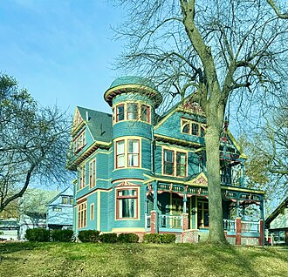
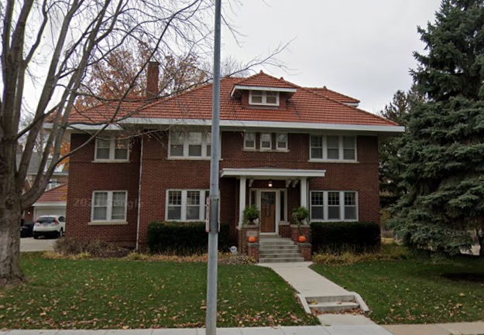
Valuation Incentive Program

Slide 36
Valuation Incentive Program
Program Overview
12-year property tax abatement program
  Freezes property valuation at pre-rehab level for 8 years.
  After freeze: valuation rises 25% per year for 4 years until full. Post-rehab value is reached.
Freeze transfers with ownership if property is sold

Slide 37
Valuation Incentive Program
VIP — Basic Requirements
Property must be:
  Listed on the National Register (individually or contributing)
  OR locally landmarked
  Taxable (commercial, residential, or owner-occupied).
Rehab cost must equal ≥ 25% of base-year assessed value (value at application).
Part 2 application must be submitted before work begins.
Rehab must be completed within 2 years (extensions possible for large projects).
All interior & exterior work is reviewed for compliance with the Standards.
Properties within an active 12-year VIP cycle are not eligible until it lapses.
Eligible properties: income-producing, owner-occupied homes, and farmsteads (freeze applies to farmstead buildings only, not farmland).

Slide 38
Valuation Incentive Program
VIP — Before Applying
Consult a tax/accounting professional to confirm program benefits.
Work with NeSHPO early to understand preservation standards.
Read VIP instructions carefully; contact NeSHPO with questions.
Application is a 3-part process — all parts must be completed.

Slide 39
Valuation Incentive Program
VIP - Part 1
Determines the subject property as a “historically significant real property” for the purposes of the VIP program. All applicants must fill out a Part 1 application, including those properties individually listed on the National Register of Historic Places.
VIP - Part 2 – Preliminary Cert of Rehab
If work commences before the submittal of a Part 2, the project is ineligible for the VIP program.
Existing conditions of the property and all proposed work to the interior and exterior of the subject property must be described in this application.
VIP - Part 3 – Final Cert of Rehab
Determines if all the completed work on the subject property conforms to the Standards.
Sent to County Assessor who initiates the freeze Jan 1 of following year.

