Slide 1

Section 106: Review and Compliance
Haylee Rose
Standing Structures Review and Compliance Coordinator
Nebraska State Historic Preservation Office
Haylee.Rose@Nebraska.gov

Slide 2
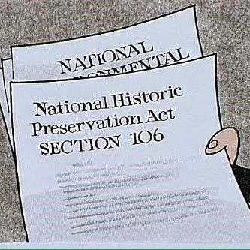
What is Section 106?
Codified in law via National Historic Preservation Act (NHPA) of 1966 §36 CFR Part 800
Federal undertaking: projects involving federal funding, federal land, a federal license, or a federal permit
  Often, the state government subgrants federal money, which is what triggers the Section 106 review process
  Federal agencies must consider the potential effects of their undertakings
Requires SHPO to review federal undertakings to assess potential effects to historic properties within a 30-day review period
Encourages but does not mandate preservation

Slide 3
Why does Section 106 exist?

Slide 4
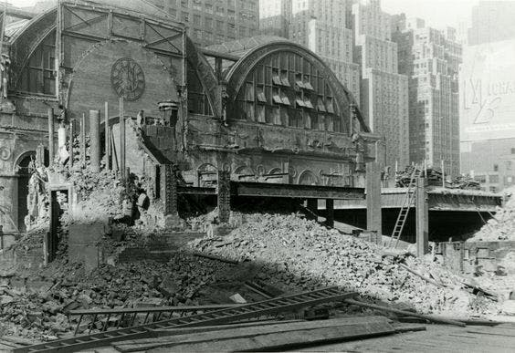
National Historic Preservation Act of 1966
Congress established the NHPA to preserve the historical and cultural foundations of the nation.
  State Historic Preservation Offices (SHPO) in every state and territory
  National Register of Historic Places (NRHP)
  Tax Credit Programs
  Tribal Historic Preservation Offices (THPO)
  Section 106 Reviews
Was enacted in response to the Urban Renewal Act, the Interstate Highway Act, and the demolition of Penn Central Station in New York

Slide 5
What does Section 106 have to do with the Main Street Network?

Slide 6
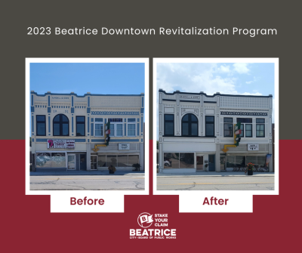
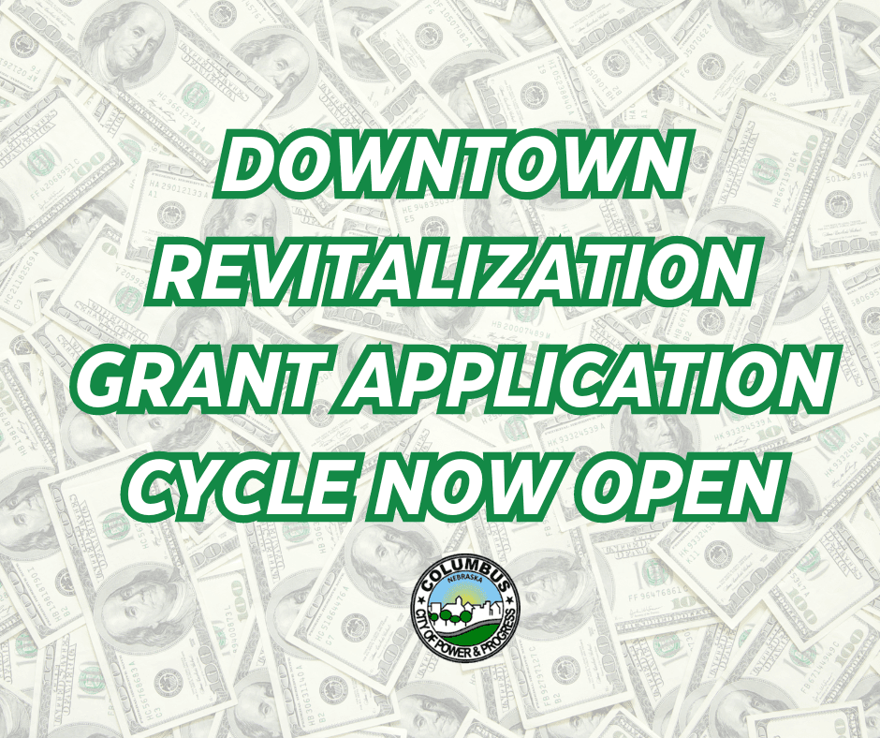
Historic Preservation and Nebraska’s Main Streets
Beatrice DTR Grant, 2023
Columbus DTR Grant, 2024

Slide 7
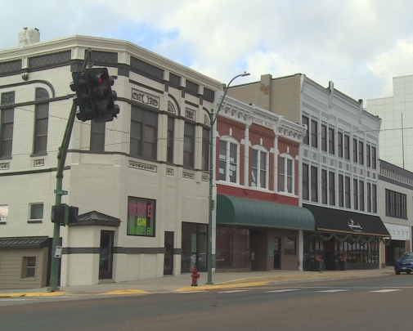
Historic Preservation and Downtown Revitalization
The purpose of the Downtown Revitalization (DTR) Opportunity is to leverage investments that will contribute to the revitalization or redevelopment of downtown infrastructure and develop a greater capacity for growth, addressing health and safety concerns and commercial revitalization within the traditional business centers of our Nebraska communities. This provides a sound basis for fostering local economic development through public and private sector partnerships. This recognizes the importance of the condition and viability of a downtown to increase the community’s tax base and cultivates a tangible center for community activity. These projects directly relate to business retention, expansion, and location decisions, recognizing that downtowns reflect the economic core and persona of our communities.
York Downtown Revitalization Project, 2022

Slide 8
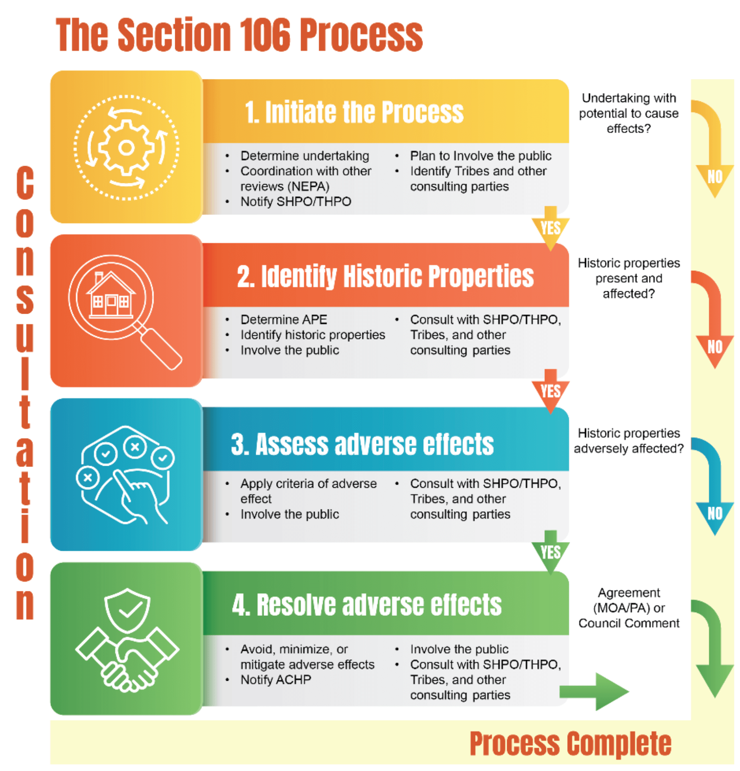
Section 106 Review Process
Initiate Section 106 Review (Federal Agency or Designee)
Identification of Historic Properties (NESHPO)
Assessment of Effects to Historic Properties (NESHPO)
Resolution of Adverse Effects
(Designee/Federal Agency/ACHP/NESHPO)

Slide 9
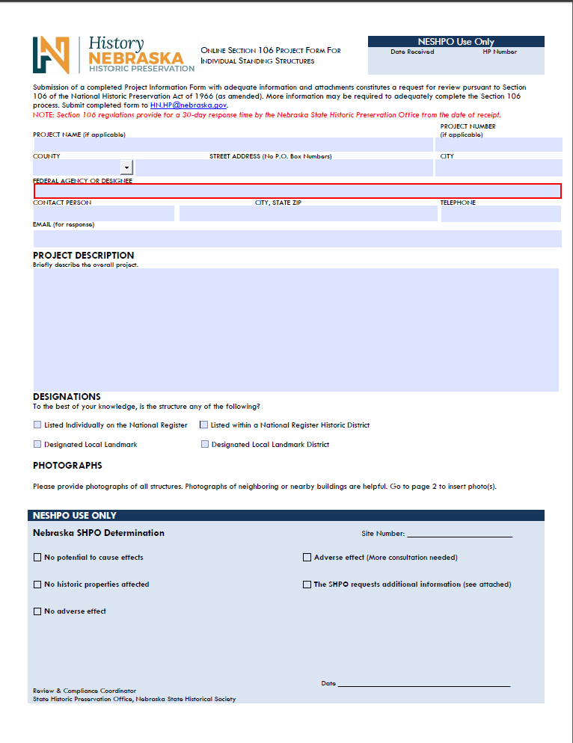
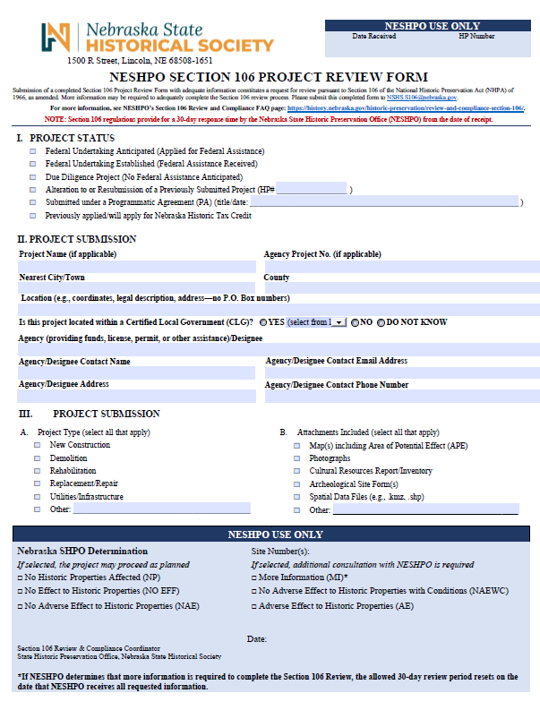
Initiation of Section 106 Review
Federal agency (or designee) submits a request for review to our office.
Determine if there is an undertaking.
  Any activity with federal funding, permitting, licensing, or is on federal land that could affect historic properties.
SHPO determines if the property is listed individually, in a historic district, or eligible for listing.
If you are wondering whether a property will be considered historic prior to the Section 106 process, our office is always happy to consult on preliminary determinations of eligibility
Notes:
Talk a bit on Phase I, II, and III

Slide 10
What Do We Consider in the Review Process?
For all types of projects:
What type of resource is it?
Is it in an existing historic district or eligible one?
Is it already listed on the National Register of Historic Places?
Has the area been surveyed before with a National Register determination previously made?
Does the building or site still retain its historic integrity?
How will the proposed undertaking affect the qualities that qualify it for listing on the National Register?
What makes a property significant enough to be on the National Register?
Criterion A: Association with significant events or patterns of events
Criterion B: Association with the lives of persons significant to our past
Criterion C: Architectural significance
Criterion D: Ability to yield future information

Slide 11
Assessment of Effects to Historic Properties
IF NOT LISTED/NOT ELIGIBLE: The project receives a “No Historic Properties Affected” sign off
IF IT IS LISTED/ELIGIBLE: We study the project plans and try to anticipate their effects on historic properties, using the Secretary of the Interior’s (SOI) Standards for the Treatment of Historic Properties
After we have reviewed the proposed scope of work and have determined the property is historic, then either a No Adverse Effect, No Adverse Effect with Conditions, or Adverse Effect determination is issued
No Historic Properties: The resource is not considered eligible for the NRHP
No Adverse Effect: Potentially eligible/eligible/listed resources present but the scope of work has no adverse effect on the resources ability to convey its historic significance or integrity
No Adverse Effect with Conditions: Potentially eligible/eligible/listed resources present but the activities proposed can be modified to avoid adverse effects to historic features.
Adverse Effect: Potentially eligible/eligible/listed resources present but the scope of work cannot be modified to avoid adverse effects requiring mitigation for the project to proceed.

Slide 12
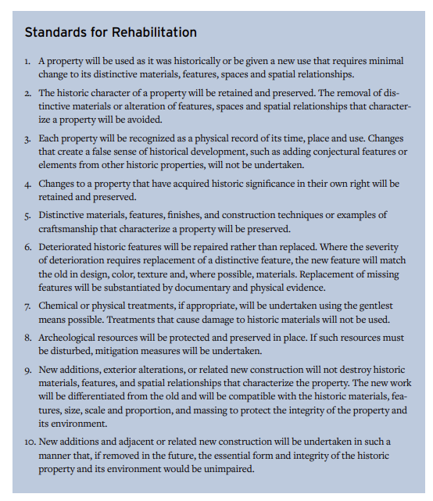
Secretary of the Interior's Standards
National standards for the preservation, rehabilitation, restoration, or reconstruction of historic structures
National Park Service Preservation Breifs provide treatment recommendations for the most historically appropriate substitute materials and restoration techniques
If a property is determined eligible for the National Register and the scope of work does not meet the Secretary of the Interior’s standards, then an Adverse Effect is issued

Slide 13
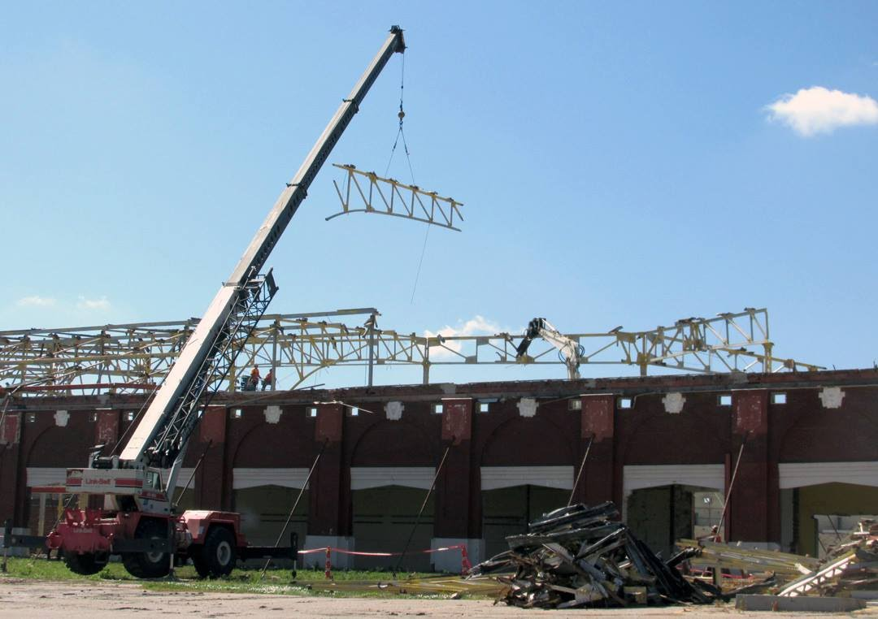
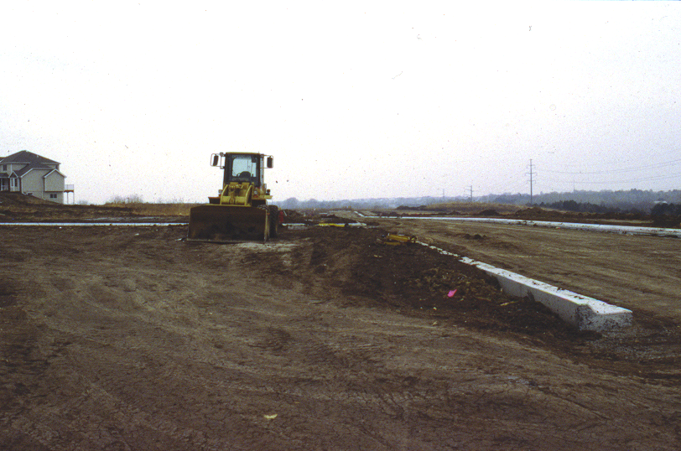
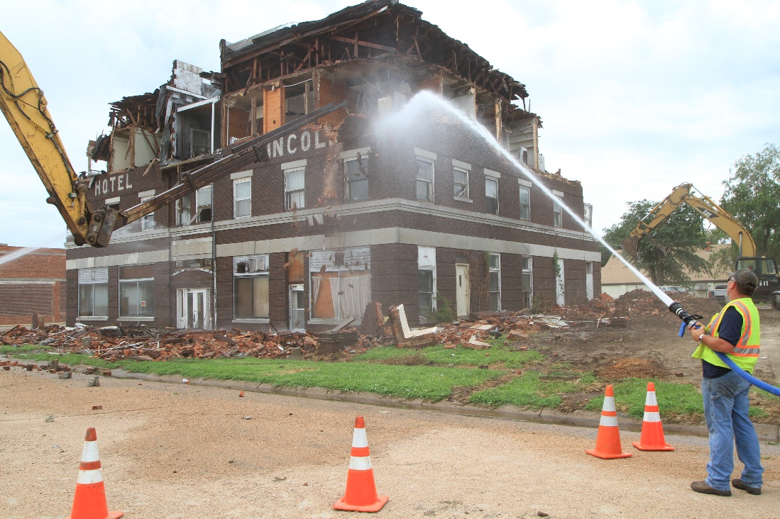
Adverse Effects
Examples: Physical destruction or damage, alteration, or moving of a historic resource to a new location

Slide 14
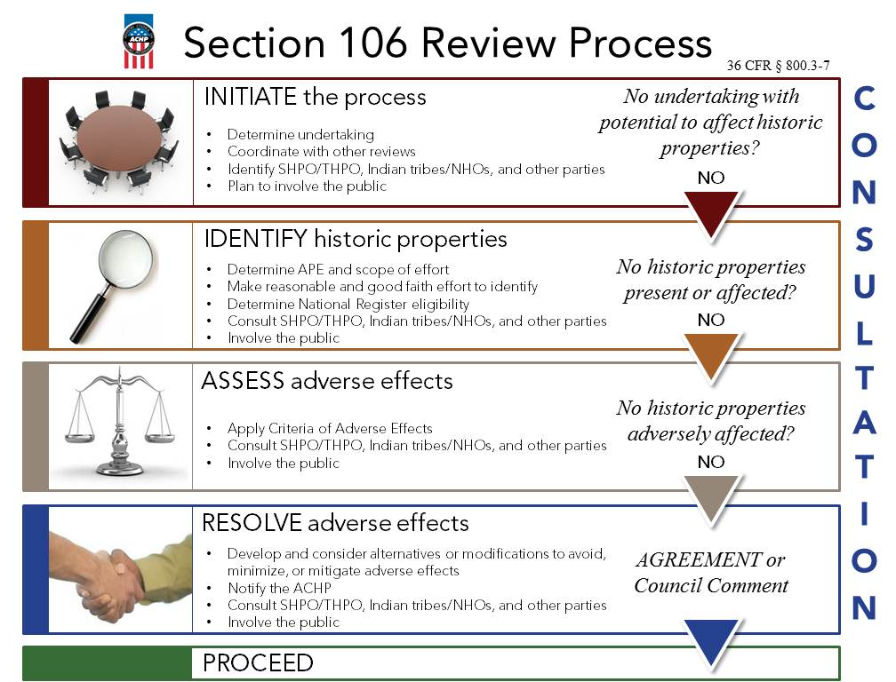
Adverse Effects Process
The SHPO will try and work with the applicant to get a No Adverse Effects with Conditions determination. However if this is not possible, then the SHPO will issue an Adverse Effect determination which will require the applicant to reach out the the Advisory Council on Historic Preservation (ACHP) to see if they would like to be part of the mitigation process (the ACHP responds within 15-30 days).
Once the ACHP has decided if they would like to participate, the federal agency that is responsible for the undertaking will propose mitigation strategies, and the SHPO will concur or suggest appropriate alternatives. Once a mitigation plan has been agreed upon then a Memorandum of Agreement (MOA) is written and signed by the SHPO and Federal agency/designee.

Slide 15
Mitigation of Adverse Effects
SHPO and designee consult “to develop and evaluate alternatives or modifications that could AVOID, MINIMIZE, or MITIGATE adverse effects.
Consider Alternatives (e.g., different materials and/or locations, alternative methods, etc.) Resolution may include finding some creative way to do something for the public benefit, if nothing else (e.g., informational panels, documentation, similar national register nomination, survey of a specific type of resource). However, it is important to note the agency proposing the Adverse Effect is responsible for proposing mitigation projects and is not done until after the Adverse Effect determination has been officially made.
Resolution agreed on? The NESHPO will write a Memorandum of Agreement (MOA) to document what each party is responsible for. Traditionally, recordation is done prior to the work being started, and other mitigation efforts are done within a year of the project’s completion. Timelines can be flexible based on the needs of the applicant.

Slide 16
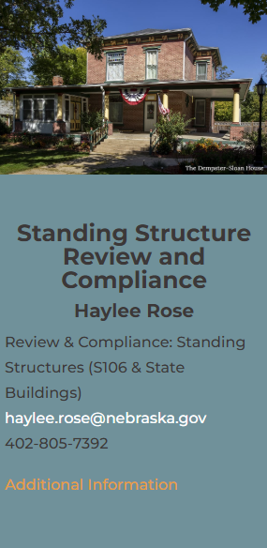

Questions?

